Slide 1


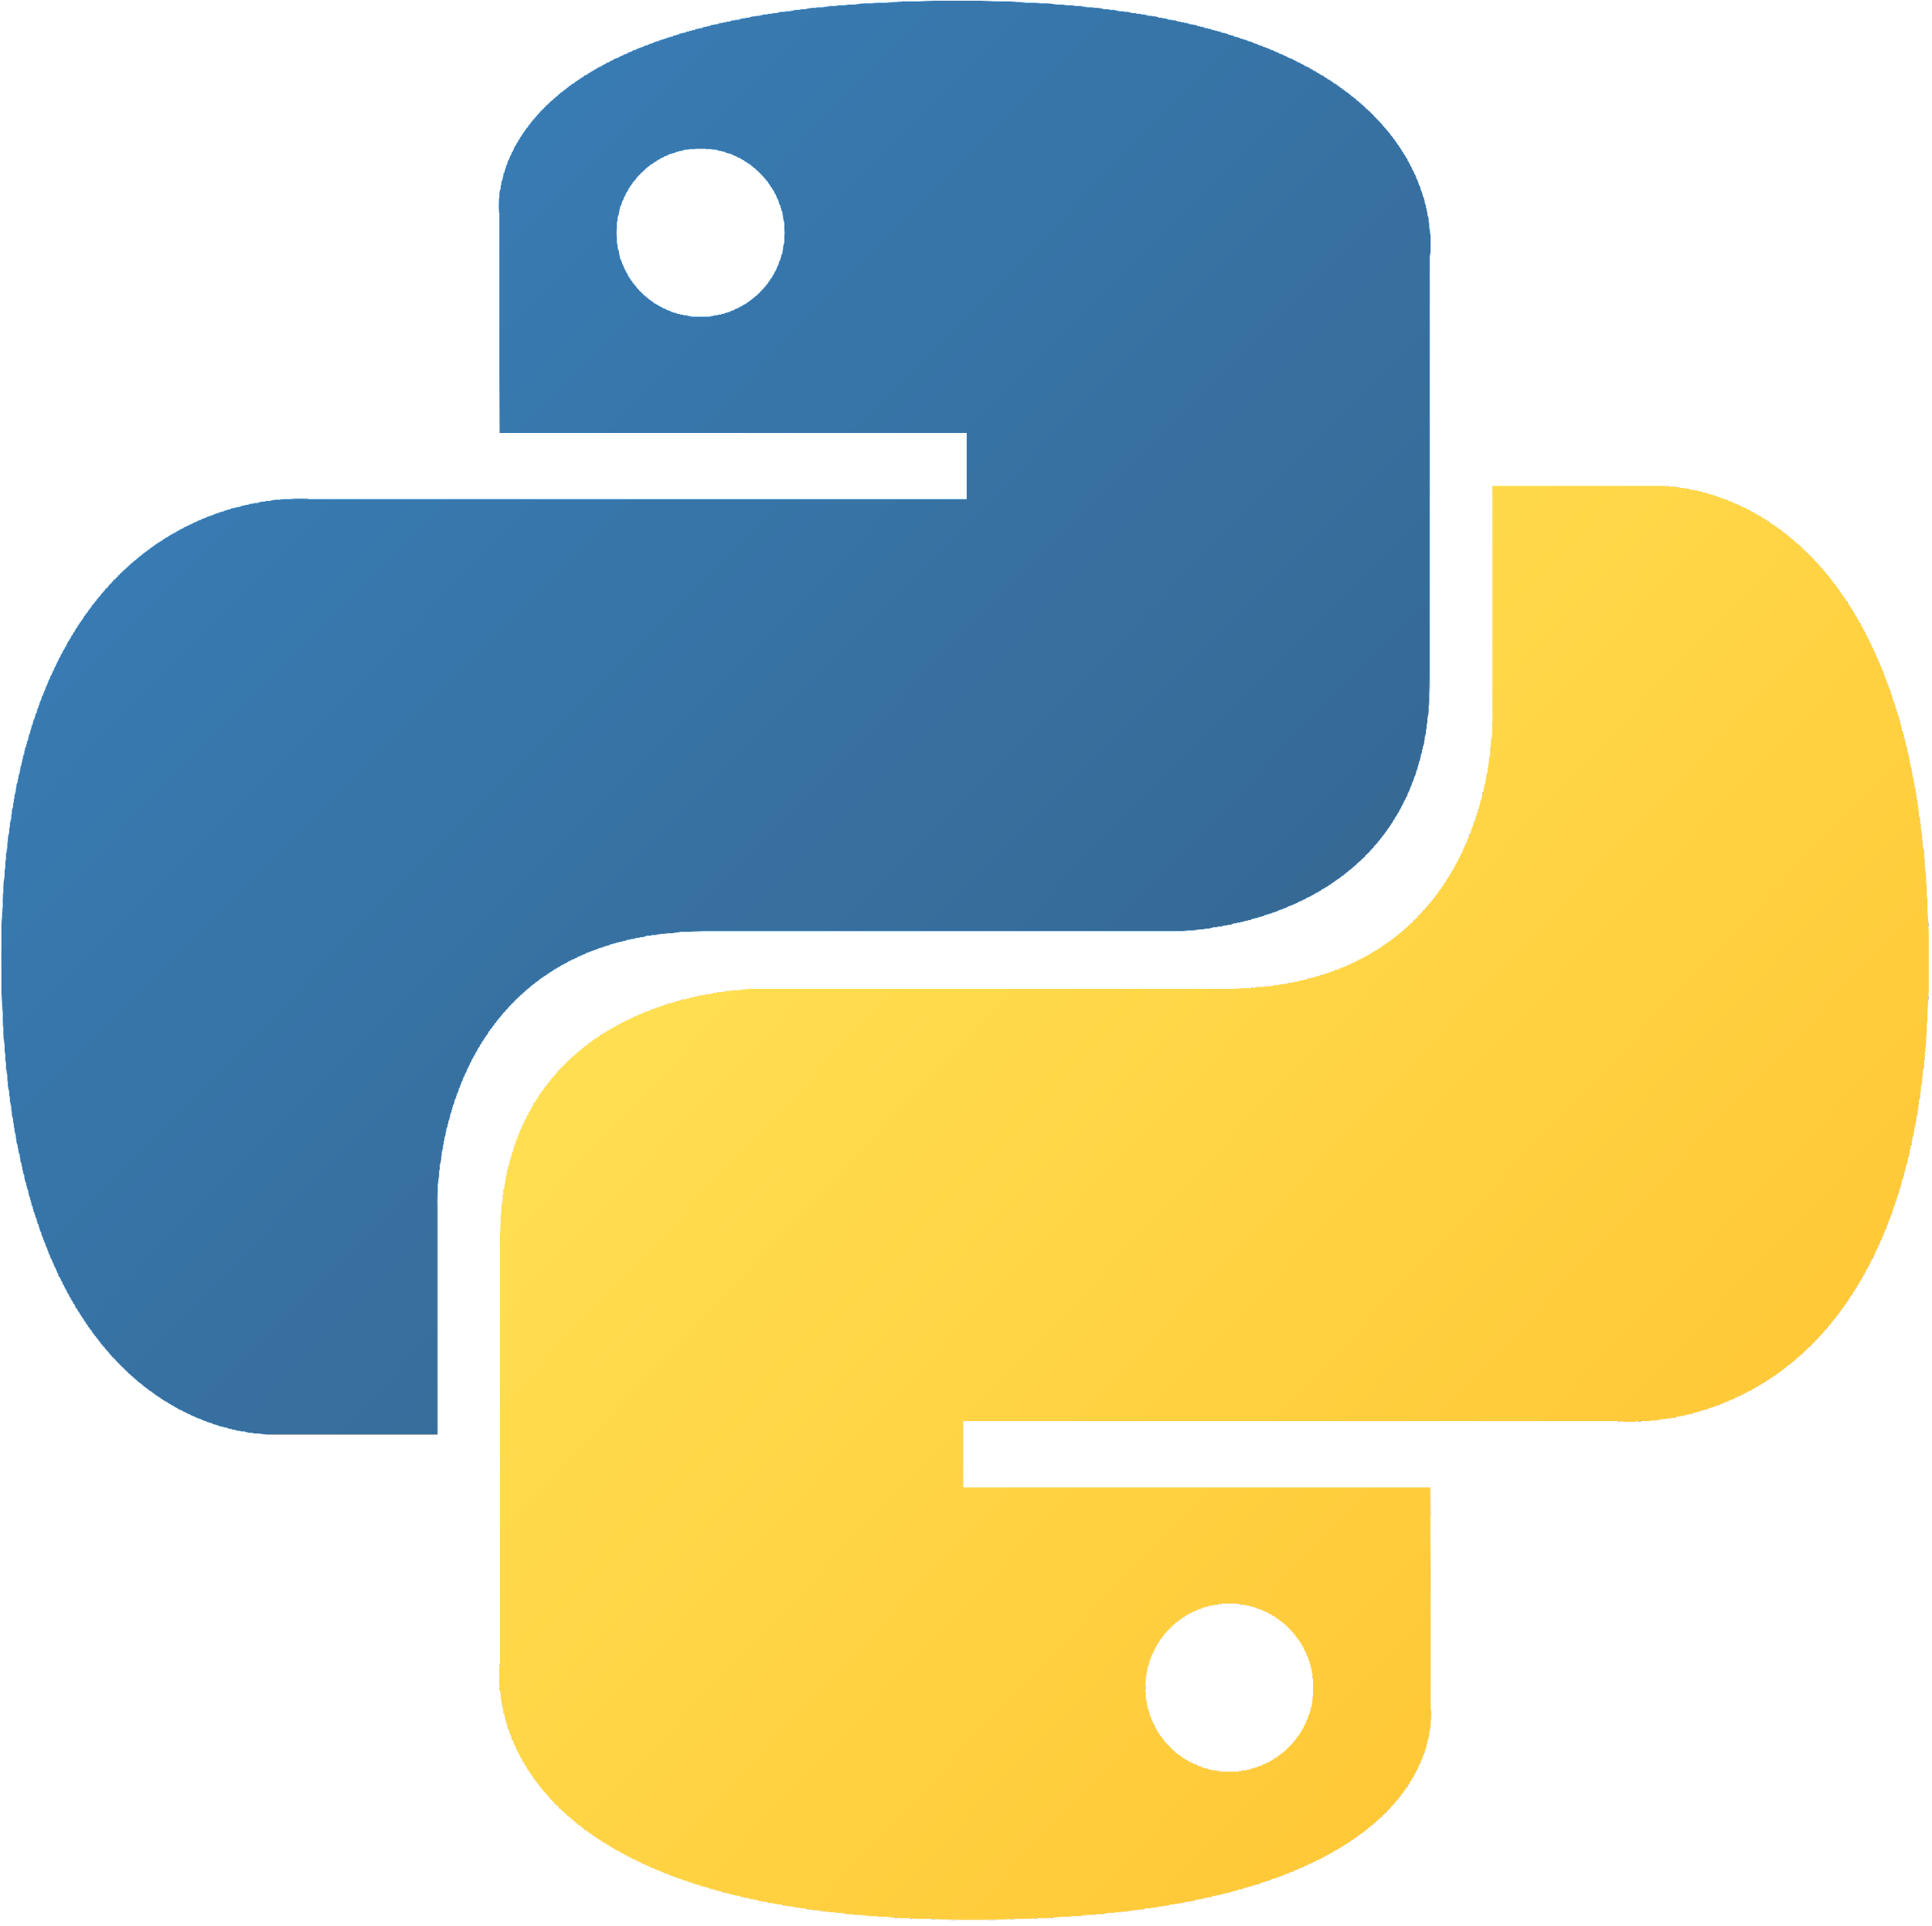



LEARNING PYTHON
MY
JOURNAL
TO PYTHON
沈愛希
SHANE ASHLY
G. BIRAD

Slide 2

AGENDA:
Python
Python Syntax
Python Comments
Python Variables
Input and Output: input() and print()
Python Data Types
Python Numbers
Python Strings
Python Booleans

Slide 3
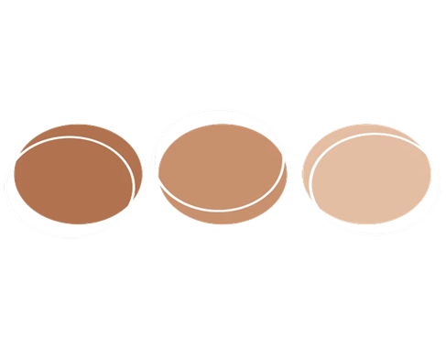

Python Operators
Python Lists
Python Tuples
Python Dictionaries
Python If…Else
Python While Loops
Python For Loops
Python Functions
Python Lambda

Slide 4

What is Python? Python is a popular programming language. It was created by Guido van Rossum, and released in 1991. It is used for: web development (server-side), software development, mathematics, system scripting.
PYTHON

Slide 5

What can Python do?
Python can be used on a server to create web applications.
Python can be used alongside software to create workflows.
Python can connect to database systems. It can also read and modify files.
Python can be used to handle big data and perform complex mathematics.
Python can be used for rapid prototyping, or for production-ready software development.

Slide 6
Why Python?
Python works on different platforms (Windows, Mac, Linux, Raspberry Pi, etc).
Python has a simple syntax similar to the English language.
Python has syntax that allows developers to write programs with fewer lines than some other programming languages.
Python runs on an interpreter system, meaning that code can be executed as soon as it is written. This means that prototyping can be very quick.
Python can be treated in a procedural way, an object-oriented way or a functional way.

Slide 7

Why to Learn Python
Python is a very popular programming language today and often needs an introduction. It is widely used in various business sectors, such as programming, web development, machine learning, and data science.
Python is a general-purpose, versatile and popular programming language. It’s great as a first language because it is concise and easy to read, and it is also a good language to have in any programmer’s stack as it can be used for everything from web development to software development and scientific applications.

Slide 8
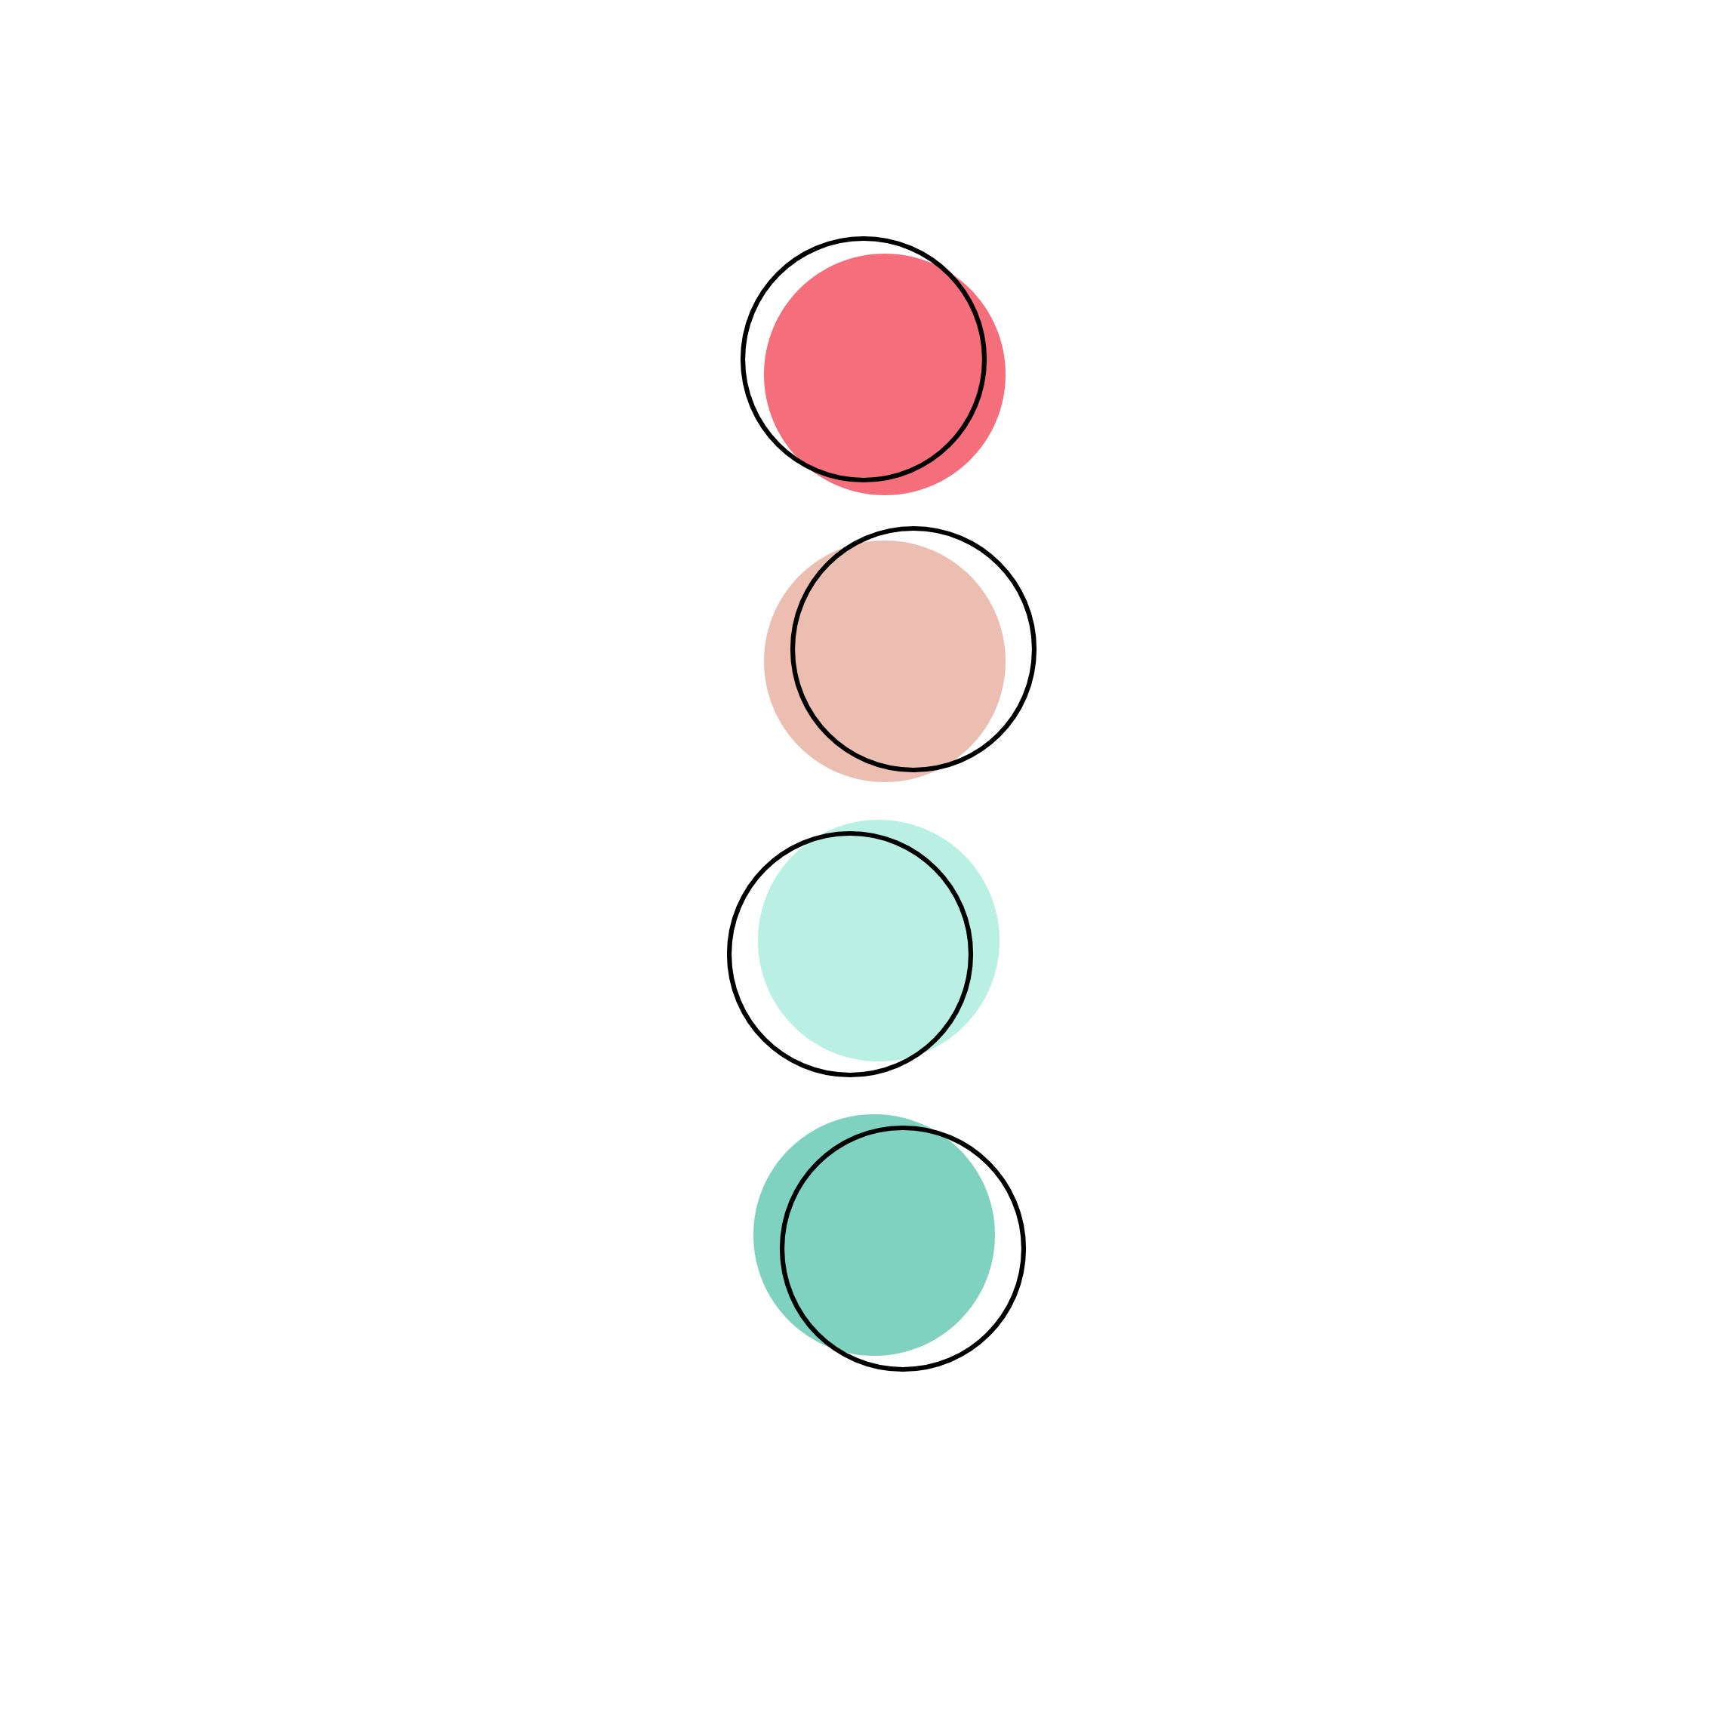






Python Jobs
Python is not only one of the most popular programming languages across the globe, but it is one that offers the most promising career opportunities as well. This demand for Python developers is increasing every year. There is a reason why this high-level programming language is so popular.
There are big companies that uses python programming language such as
Pinterest
Facebook
Youtube
Google
Netflix

Slide 9
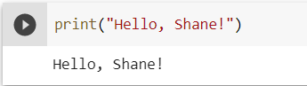
Example:

Slide 10
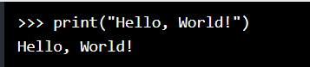
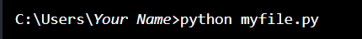
PYTHON SYNTAX
Execute python syntax
As we learned in the previous page, Python syntax can be executed by writing directly in the Command Line
Or by creating a python file on the server, using the .py file extension, and running it in the Command Line:

Slide 11
Python Indentation
Indentation refers to the spaces at the beginning of a code line.
Where in other programming languages the indentation in code is for readability only, the indentation in Python is very important.
Python uses indentation to indicate a block of code.

Slide 12
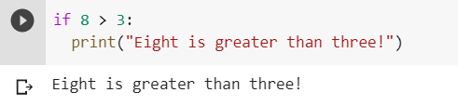
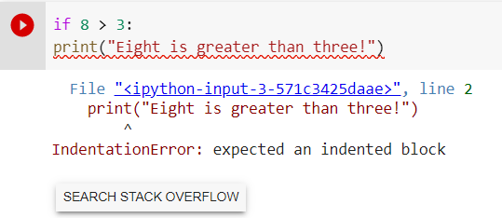
Example:
Python will give you an error if you skip the indentation:
Example
Syntax Error:

Slide 13
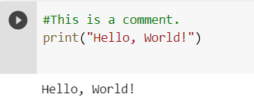
PYTHON COMMENTS
Comments can be used to explain Python code.
Comments can be used to make the code more readable.
Comments can be used to prevent execution when testing code.
Creating a Comment
Comments starts with a #, and Python will ignore them:
Example:

Slide 14
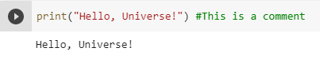
Comments can be placed at the end of a line, and Python will ignore the rest of the line:
Example:

Slide 15
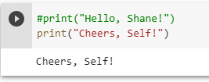
A comment does not have to be text that explains the code, it can also be used to prevent Python from executing code:
Example:

Slide 16
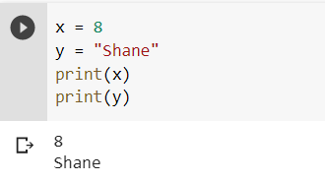
PYTHON VARIABLES
Variables are containers for storing data values.
Creating Variables
Python has no command for declaring a variable.
A variable is created the moment you first assign a value to it.

Slide 17
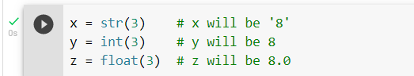
Casting
If you want to specify the data type of a variable, this can be done with casting.
Example:

Slide 18
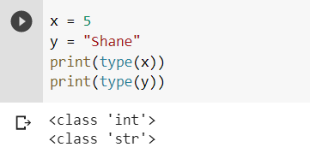
Get the Type
You can get the data type of a variable with the type() function.
Example:

Slide 19
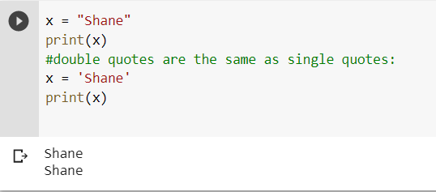
Single or Double Quotes?
String variables can be declared either by using single or double quotes:
Example:

Slide 20
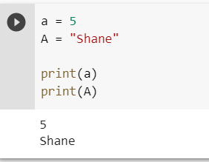
Case-Sensitive
Variable names are case-sensitive.
Example:

Slide 21
Python - Variable Names
Variable Names
A variable can have a short name (like x and y) or a more descriptive name (age, carname, total_volume). Rules for Python variables:A variable name must start with a letter or the underscore character
A variable name cannot start with a number
A variable name can only contain alpha-numeric characters and underscores (A-z, 0-9, and _ )
Variable names are case-sensitive (age, Age and AGE are three different variables)

Slide 22
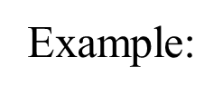
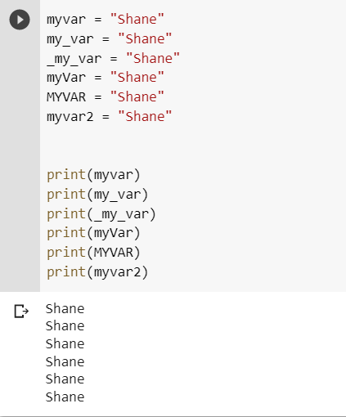
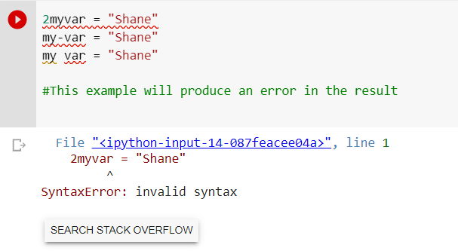
Legal variable names:
Illegal variable names:
Example:

Slide 23
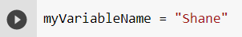
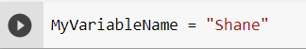
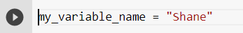
Multi Words Variable Names
Variable names with more than one word can be difficult to read.
There are several techniques you can use to make them more readable:
Camel Case
Each word, except the first, starts with a capital letter:
Pascal Case
Each word starts with a capital letter:
Snake Case
Each word is separated by an underscore character:

Slide 24


INPUT AND OUTPUT

Slide 25
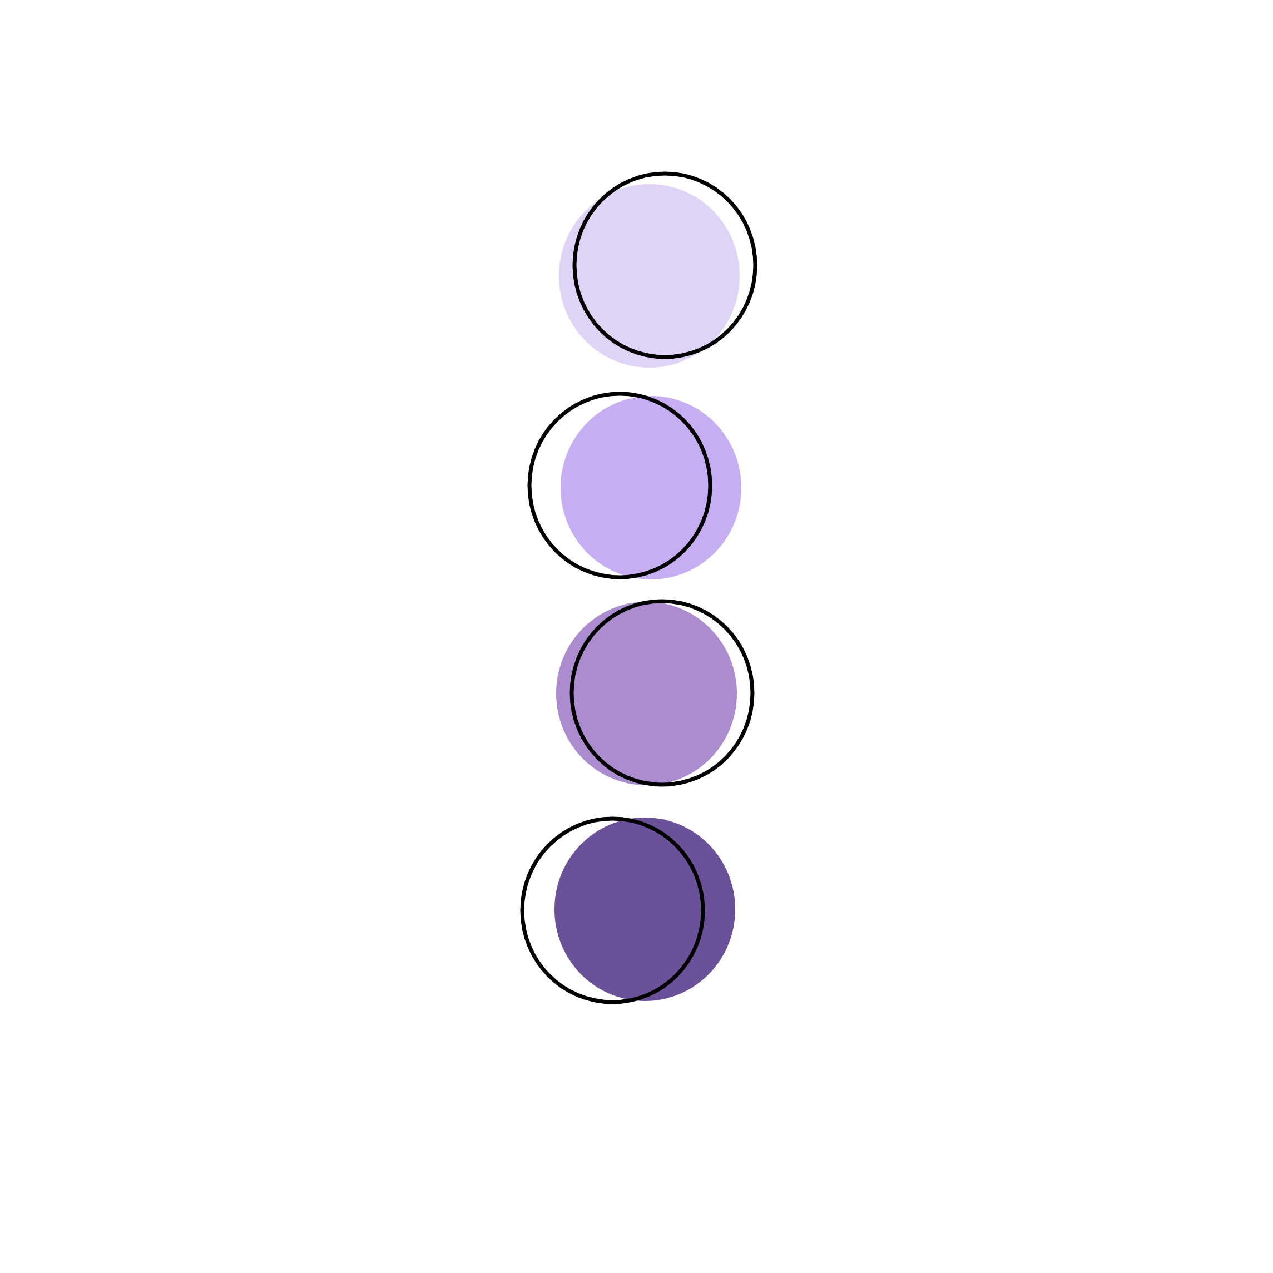
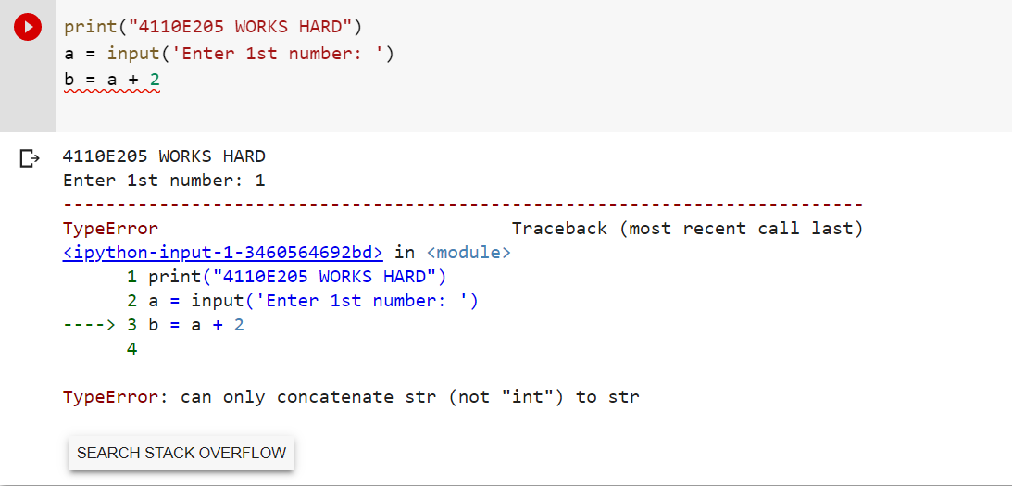
QUESTION:
DATA TYPE

Slide 26
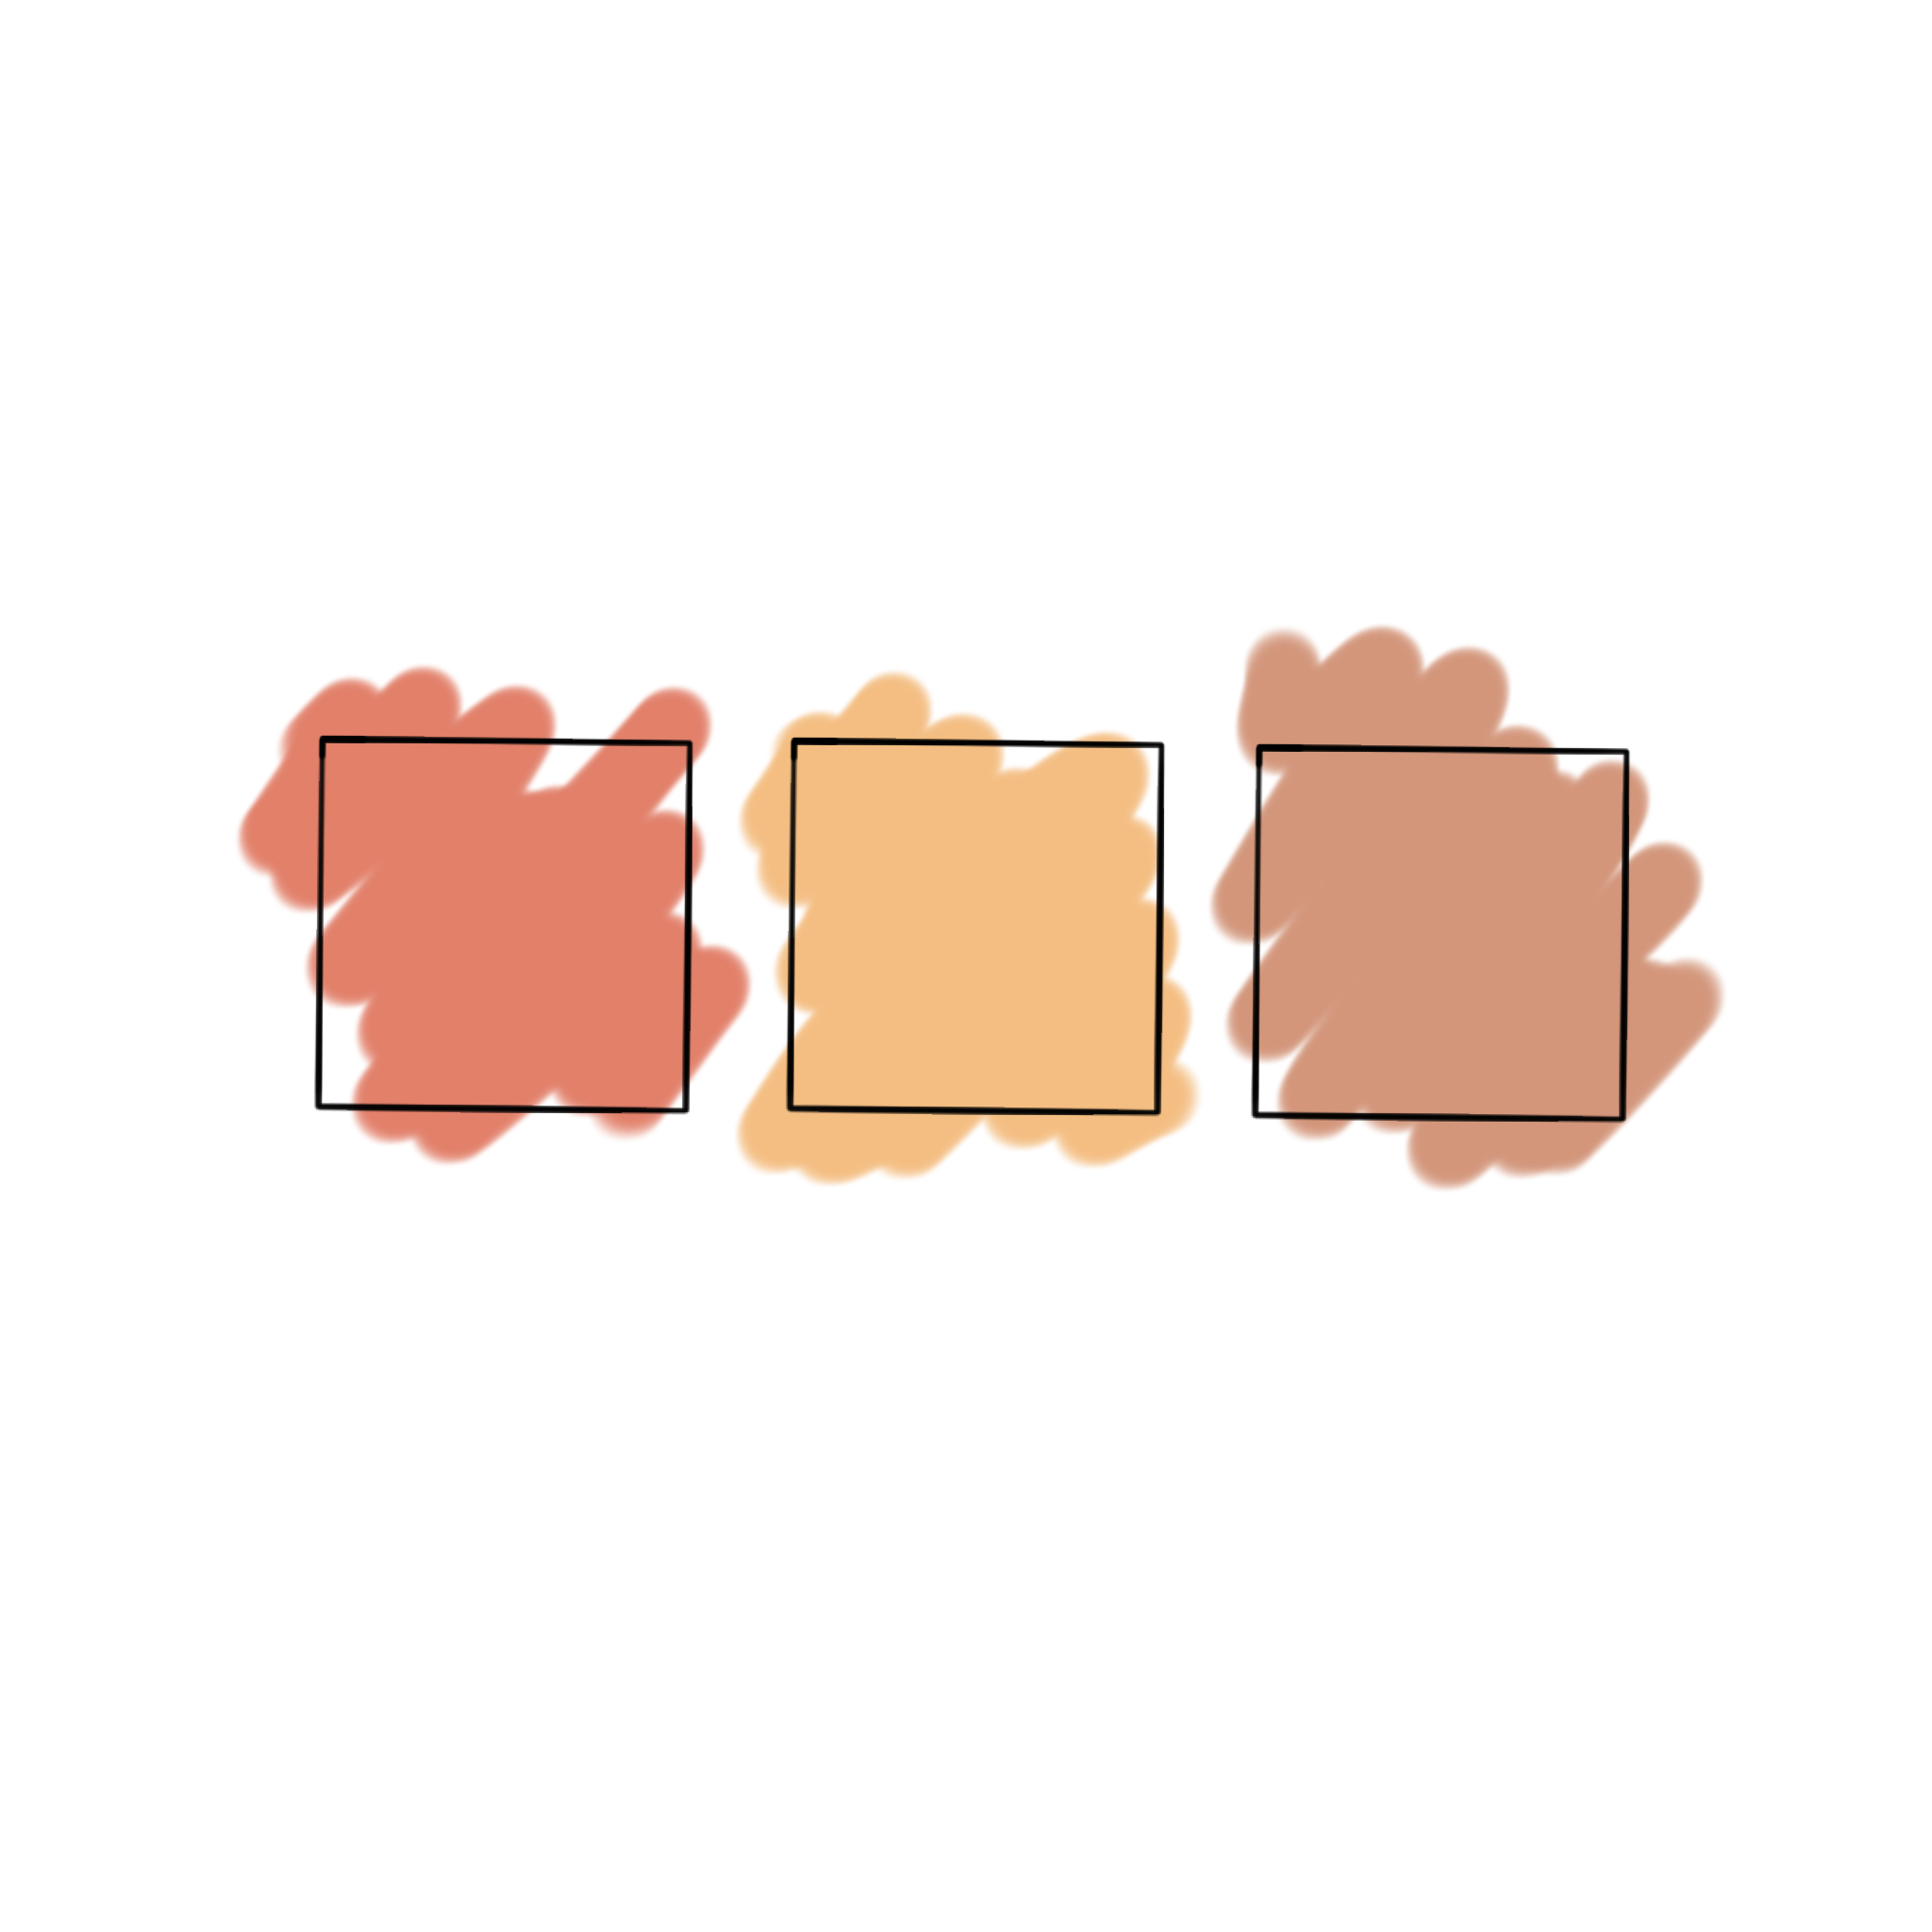
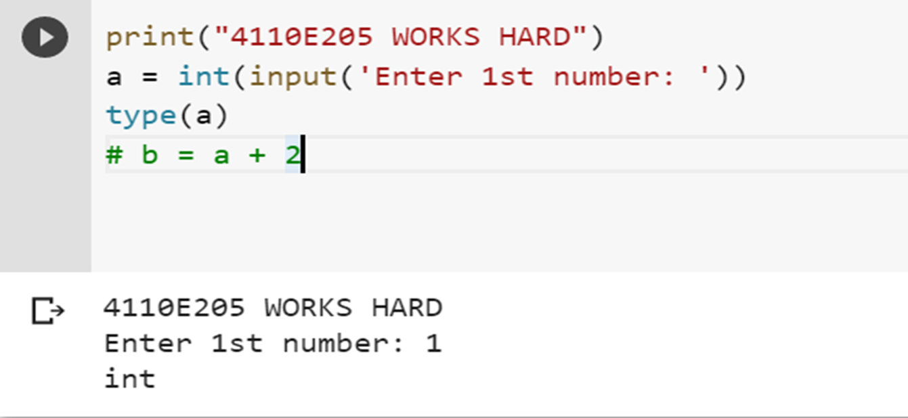
WAY 1:

Slide 27

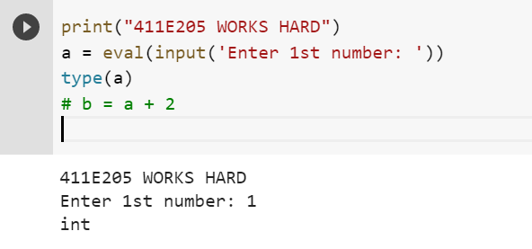
WAY 2:

Slide 28
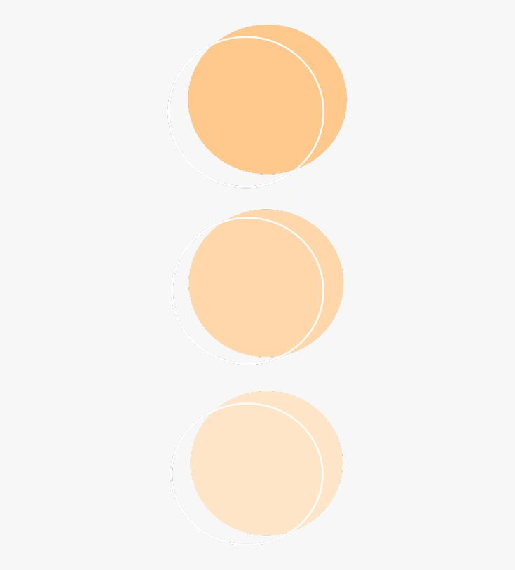
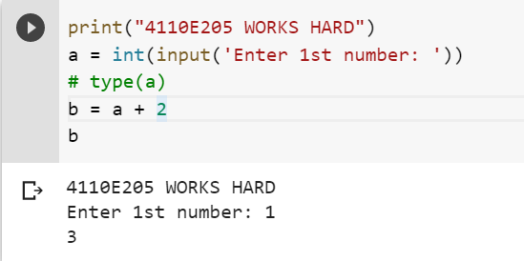
ANSWER 1:

Slide 29

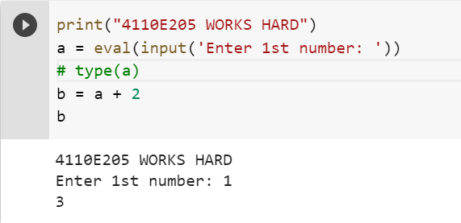
ANSWER 2:

Slide 30

PYTHON DATA
TYPES

Slide 31
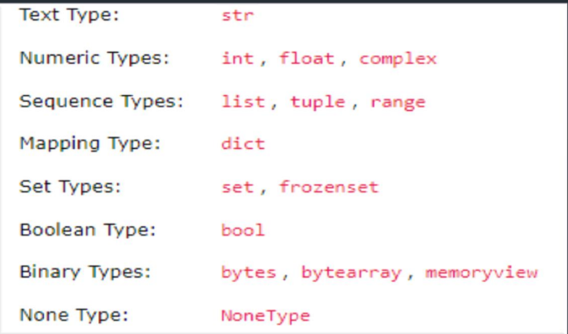
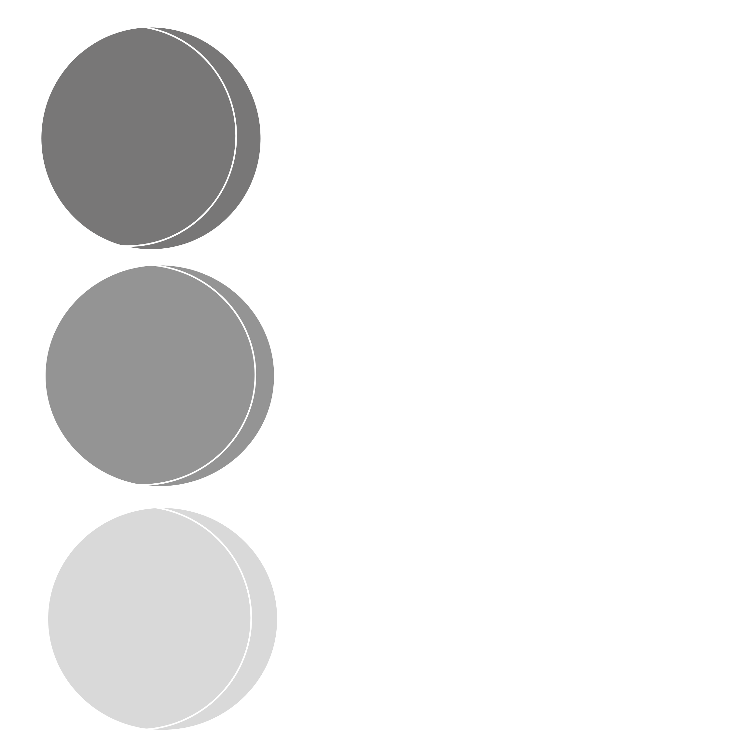
Data Types
In programming, data type is an important concept.
Variables can store data of different types, and different types can do different things.
Python has the following data types built-in by default, in these categories:

Slide 32


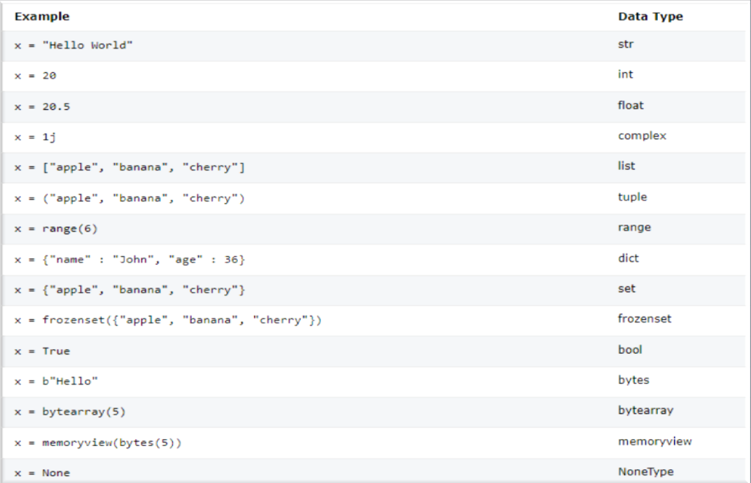
Setting The Specific Data

Slide 33
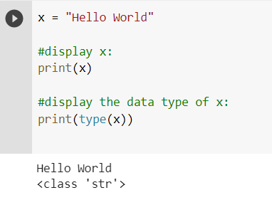
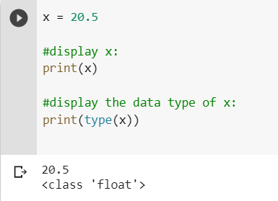
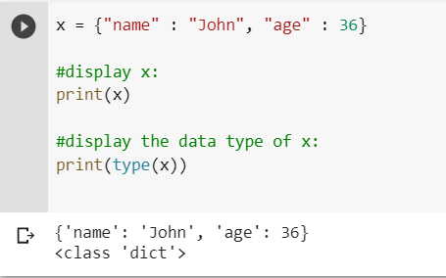
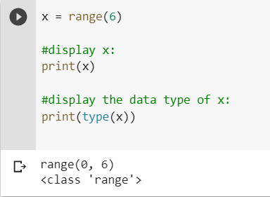
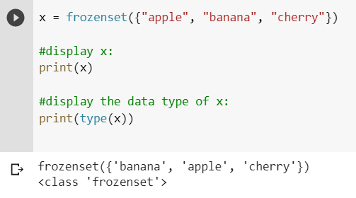
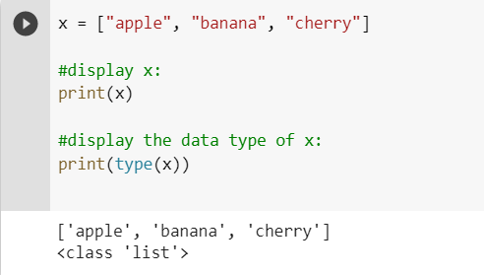
EXAMPLE:

Slide 34
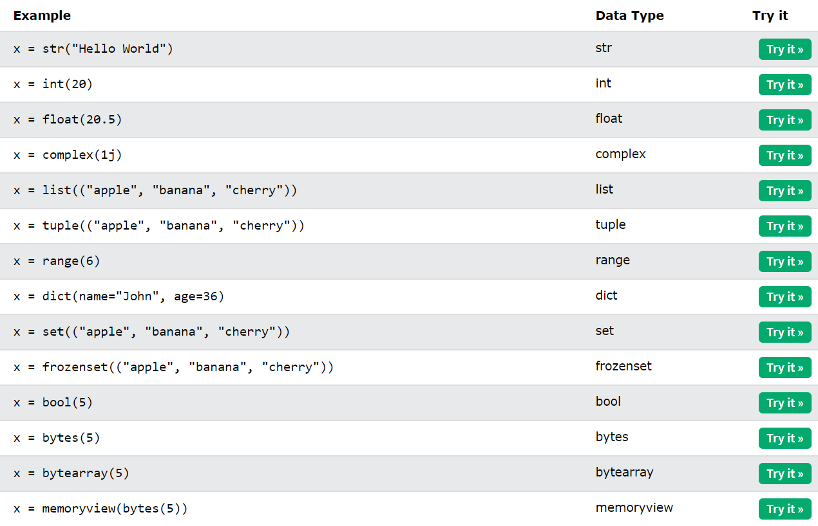
Setting the Specific Data Type
If you want to specify the data type, you can use the following constructor functions:

Slide 35
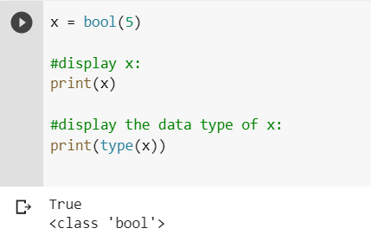
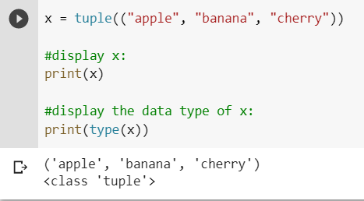
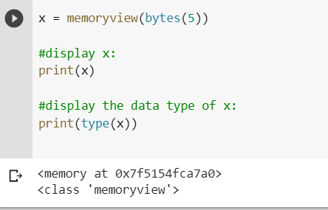
EXAMPLE:

Slide 36
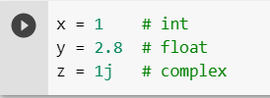
PYTHON NUMBERS
There are three numeric types in Python:
int
Float
complex
Variables of numeric types are created when you assign a value to them:

Slide 37
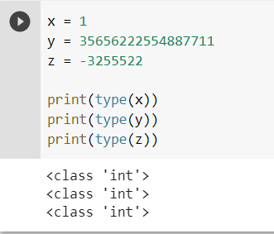
Int
Int, or integer, is a whole number, positive or negative, without decimals, of unlimited length.
Example
Integers:

Slide 38
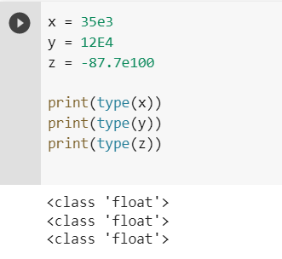
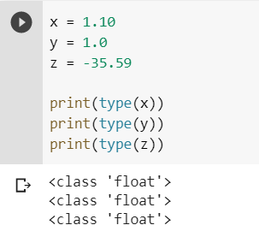
Float
Float, or "floating point number" is a number, positive or negative, containing one or more decimals.
Float can also be scientific numbers with an "e" to indicate the power of 10.
Example Floats:

Slide 39
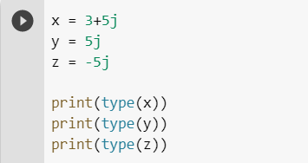
Complex
Complex numbers are written with a "j" as the imaginary part:
Example
Complex:

Slide 40
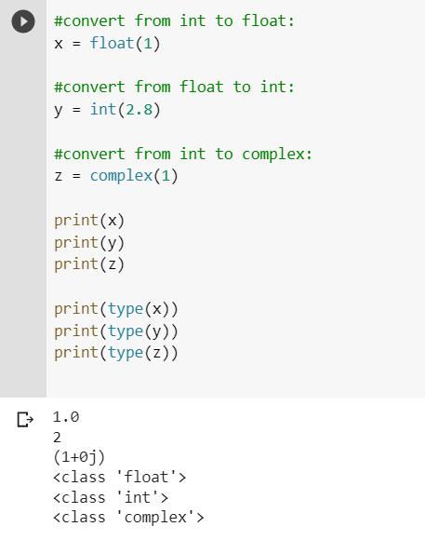
Type Conversion
You can convertfrom one type to another with the int(), float(), and complex() methods:
Example
Convert from one type to another:

Slide 41
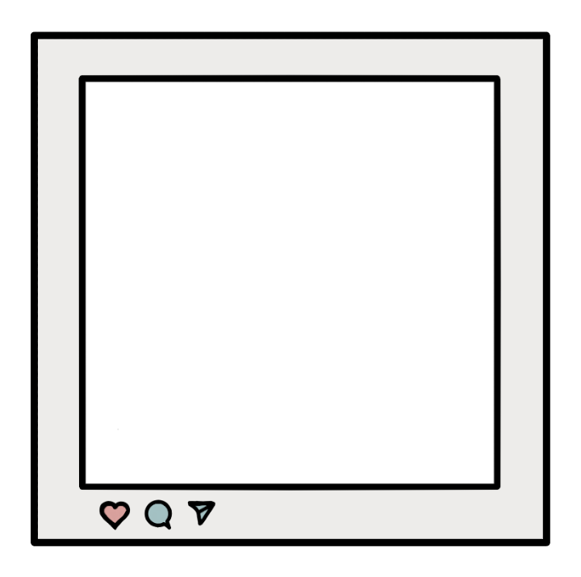



PYTHON DATA

Slide 42



DICT: KEY VALUE PAIR

Slide 43

Python
Strings

Slide 44

Strings
Strings in python are surrounded by either single quotation marks, or double quotation marks.
'hello' is the same as "hello".
You can display a string literal with the print() function:

Slide 45

Assign String to a Variable
Assigning a string to a variable is done with the variable name followed by an equal sign and the string:
Example:

Slide 46

Python - Modify Strings
Python has a set of built-in methods that you can use on strings.
Upper Case
Example
The upper() method returns the string in
upper case:

Slide 47

Lower Case
Example
The lower() method returns the string in lower case:

Slide 48
Python
Booleans

Slide 49

BOOLEAN VALUES
In programming you often need to know if an expression is True or False.
You can evaluate any expression in Python, and get one of two answers, True or False.
When you compare two values, the expression is evaluated and Python returns the Boolean answer:
Example:

Slide 50

When you run a condition in an if statement, Python returns True or False:
Example:
Print a message based on whether the condition is True or False:

Slide 51

Evaluate Values and Variables
The bool () The bool () function allows you to evaluate any value, and give you True or False in return, function allows you to evaluate any value, and give you True or False in return,
Example:
Evaluate a string and a number:

Slide 52


Most Values are True
Some Values are False
Almost any value is evaluated to True if it has some sort of content.
Any string is True, except empty strings.
Any number is True, except 0.
Any list, tuple, set, and dictionary are True, except empty ones.
In fact, there are not many values that evaluate to False, except empty values, such as (), [], {}, "", the number 0, and the value None. And of course the value False evaluates to False.
Example:
The following will return False:
Example:
The following will return True:

Slide 53
PYTHON OPERATORS

Slide 54





Python Arithmetic Operators

Slide 55





Python Assignment
Operators
Arithmetic operators are used with numeric values to perform common mathematical operations:

Slide 56





Python Comparison Operators
Comparison operators are used to compare two values:

Slide 57




Python Logical Operators
Logical operators are used to combine conditional statements:

Slide 58




Python Bitwise Operators
Bitwise operators are used to compare (binary) numbers:

Slide 59


PYTHON LISTS
List
Lists are used to store multiple items in a single variable.
Lists are one of 4 built-in data types in Python used to store collections of data, the other 3 are Tuple, Set, and Dictionary, all with different qualities and usage.
Lists are created using square brackets:
Example of Create a List:

Slide 60
List Items
List items are ordered, changeable, and allow duplicate values.
List items are indexed, the first item has index [0], the second item has index [1] etc.
Ordered
When we say that lists are ordered, it means that the items have a defined order, and that order will not change.
If you add new items to a list, the new items will be placed at the end of the list.
Changeable
The list is changeable, meaning that we can change, add, and remove items in a list after it has been created.

Slide 61

Allow Duplicates
Since lists are indexed, lists can have items with the same value:
Example
Lists allow duplicate values:

Slide 62

List Items - Data Types
List items can be of any data type:
Example
String, int and boolean data types:

Slide 63
Python - List Comprehension
List Comprehension
List comprehension offers a shorter syntax when you want to create a new list based on the values of an existing list.
Example:
Based on a list of fruits, you want a new list, containing only the fruits with the letter "a" in the name.
Without list comprehension you will have to write a for statement with a conditional test inside:

Slide 64


Example:
With list comprehension you can do all that with only one line of code:
Example:

Slide 65


Python - Sort Lists
Sort List Alphanumerically
List objects have a sort() method that will sort the list alphanumerically, ascending, by default:
Example
Sort the list alphabetically:
Example
Sort the list numerically:

Slide 66


Join Two Lists
There are several ways to join, or concatenate, two or more lists in Python.
One of the easiest ways are by using the + operator.
Another way to join two lists is by appending all the items from list2 into list1, one by one:
Example
Join two list:
Example
Append list2 into list1:

Slide 67

Python - List Methods
List Methods
Python has a set of built-in methods that you can use on lists.

Slide 68


PYTHON TUPLES
Tuples are used to store multiple items in a single variable.
Tuple is one of 4 built-in data types in Python used to store collections of data, the other 3 are List, Set, and Dictionary, all with different qualities and usage.
A tuple is a collection which is ordered and unchangeable.
Tuples are written with round brackets.
Example
Create a Tuple:

Slide 69

PYTHON DICTIONARIES
Dictionary
Dictionaries are used to store data values in key:value pairs.
A dictionary is a collection which is ordered*, changeable and do not allow duplicates.
Dictionaries are written with curly brackets, and have keys and values:

Slide 70

Example
Create and print a dictionary:

Slide 71

Dictionary Items
Dictionary items are ordered, changeable, and does not allow duplicates.
Dictionary items are presented in key:value pairs, and can be referred to by using the key name.
Example
Print the "brand" value of the dictionary:

Slide 72

Duplicates Not Allowed
Dictionaries cannot have two items with the same key:
Example
Duplicate values will overwrite existing values:

Slide 73

Python Dictionary Methods
Dictionary Methods
Python has a set of built-in methods that you can use on dictionaries.

Slide 74
PYTHON IF… ELSE
Python Conditions and If statements
Python supports the usual logical conditions from mathematics:
Equals: a == b
Not Equals: a != b
Less than: a < b
Less than or equal to: a <= b
Greater than: a > b
Greater than or equal to: a >= b
These conditions can be used in several ways, most commonly in "if statements" and loops.
An "if statement" is written by using the if keyword.

Slide 75

Example
If statement:
In this example we use two variables, a and b, which are used as part of the if statement to test whether b is greater than a. As a is 33, and b is 200, we know that 200 is greater than 33, and so we print to screen that "b is greater than a".

Slide 76

Elif
The elif keyword is pythons way of saying "if the previous conditions were not true, then try this condition".
Example:
In this example a is equal to b, so the first condition is not true, but the elif condition is true, so we print to screen that "a and b are equal".

Slide 77

Else
The else keyword catches anything which isn't caught by the preceding conditions.
Example:
In this example a is greater than b, so the first condition is not true, also the elif condition is not true, so we go to the else condition and print to screen that "a is greater than b".

Slide 78

You can also have an else without the elif:
Example:

Slide 79


Short Hand If
Short Hand If ... Else
If you have only one statement to execute, you can put it on the same line as the if statement.
If you have only one statement to execute, one for if, and one for else, you can put it all on the same line:
Example
Example
One line if statement:
One line if else statement:

Slide 80

PYTHON WHILE LOOPS
Python Loops
Python has two primitive loop commands:
while loops
for loops
The While Loop
With the while loop we can execute a set of statements as long as a condition is true.
Example
Print i as long as i is less than 6:

Slide 81

The break Statement
With the break statement we can stop the loop even if the while condition is true:
Example
Exit the loop when i is 3:

Slide 82

The continue Statement
With the continue statement we can stop the current iteration, and continue with the next:
Example
Continue to the next iteration if i is 3:

Slide 83

The else Statement
With the else statement we can run a block of code once when the condition no longer is true:
Example
Print a message once the condition is
false:

Slide 84
PYTHON FOR LOOPS
A for loop is used for iterating over a sequence (that is either a list, a tuple, a dictionary, a set, or a string).
This is less like the for keyword in other programming languages, and works more like an iterator method as found in other object-orientated programming languages.
With the for loop we can execute a set of statements, once for each item in a list, tuple, set etc.

Slide 85

Example
Print each fruit in a fruit list:

Slide 86

Looping Through a String
Even strings are iterable objects, they contain a sequence of characters:
Example
Loop through the letters in the
word “strawberry":

Slide 87

The range() Function
To loop through a set of code a specified number of times, we can use the range() function,
The range() function returns a sequence of numbers, starting from 0 by default, and increments by 1 (by default), and ends at a specified number.
Example
Using the range() function:

Slide 88

The range() function defaults to 0 as a starting value, however it is possible to specify the starting value by adding a parameter: range(2, 6), which means values from 2 to 6 (but not including 6):
Example
Using the start parameter:

Slide 89

The range() function defaults to increment the sequence by 1, however it is possible to specify the increment value by adding a third parameter: range(2, 30, 3):
Example
Increment the sequence with 3 (default is 1):

Slide 90

Else in For Loop
The else keyword in a for loop specifies a block of code to be executed when the loop is finished:
Example
Print all numbers from 0 to 5, and print a message when the loop has ended:

Slide 91

Note: The else block will NOT be executed if the loop is stopped by a break statement.
Example
Break the loop when x is 3, and see what happens with the else block:

Slide 92

Nested Loops
A nested loop is a loop inside a loop.
The "inner loop" will be executed one time for each iteration of the "outer loop":
Example
Print each adjective for every fruit:

Slide 93

The pass Statement
for loops cannot be empty, but if you for some reason have a for loop with no content, put in the pass statement to avoid getting an error.
Example:

Slide 94
PYTHON FUNCTIONS
A function is a block of code which only runs when it is called.
You can pass data, known as parameters, into a function.
A function can return data as a result.

Slide 95

Creating a Function
In Python a function is defined using the def keyword:
Example:

Slide 96
Arguments
Information can be passed into functions as arguments.
Arguments are specified after the function name, inside the parentheses. You can add as many arguments as you want, just separate them with a comma.
The following example has a function with one argument (fname). When the function is called, we pass along a first name, which is used inside the function to print the full name:

Slide 97

Example:

Slide 98

Number of Arguments
By default, a function must be called with the correct number of arguments. Meaning that if your function expects 2 arguments, you have to call the function with 2 arguments, not more, and not less.
Example
This function expects 2 arguments, and gets 2 arguments:

Slide 99

Arbitrary Arguments, *args
If you do not know how many arguments that will be passed into your function, add a * before the parameter name in the function definition.
This way the function will receive a tuple of arguments, and can access the items accordingly:
Example
If the number of arguments is unknown, add a * before the parameter name:

Slide 100

Keyword Arguments
You can also send arguments with the key = value syntax.
This way the order of the arguments does not matter.
Example:

Slide 101

PYTHON LAMBDA
A lambda function is a small anonymous function.
A lambda function can take any number of arguments, but can only have one expression.
Syntax
lambda arguments : expression
Example
Add 10 to argument a, and return the result:

Slide 102


Why Use Lambda Functions?
The power of lambda is better shown when you use them as an anonymous function inside another function.
Say you have a function definition that takes one argument, and that argument will be multiplied with an unknown number:
Example:
Use that function definition to make a function that always doubles the number you send in:

Slide 103

Or, use the same function definition to make a function that always triples the number you send in:
Example:

Slide 104

Or, use the same function definition to make both functions, in the same program:
Example

Slide 105

CHINESE NAME: 沈愛希 STUDENT ID: 4110E205 ENGLISH NAME: Shane Ashly G. Birad NICKNAME: Shane Email: biradshane@gmail.com GITHUB: https://github.com/4110E205/cs2022.git

